Slide 1
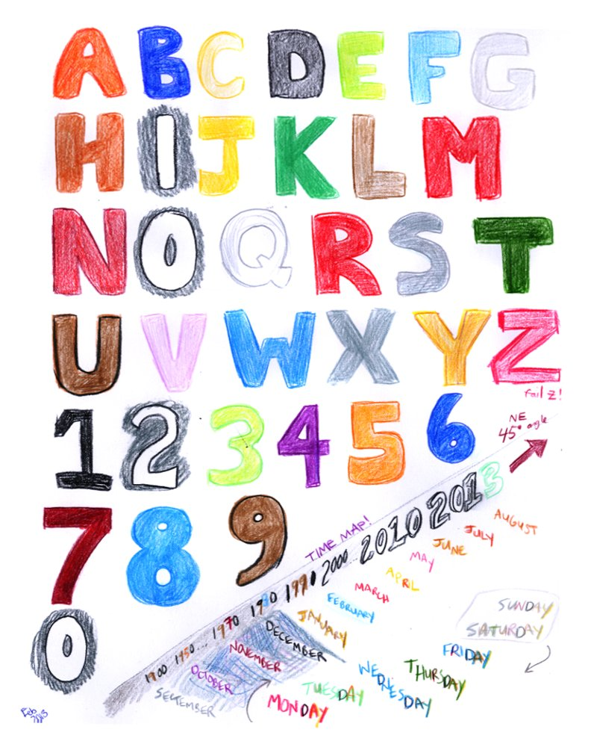


What does "red" sound like?
Notes:
Learning Intentions:
Discovering new and interesting words to describe colours in Spanish
Consider how verbs and nouns can evoke senses
Use my knowledge of two languages in a creative way

Slide 2
Notes:
Think. Pair. Share.
My favourite senses… In pairs, pupils discuss the following:
Your favourite flavour?
Your favourite texture?
Your favourite smell?
Your favourite sound?
Your favourite picture/view/image?

Slide 3

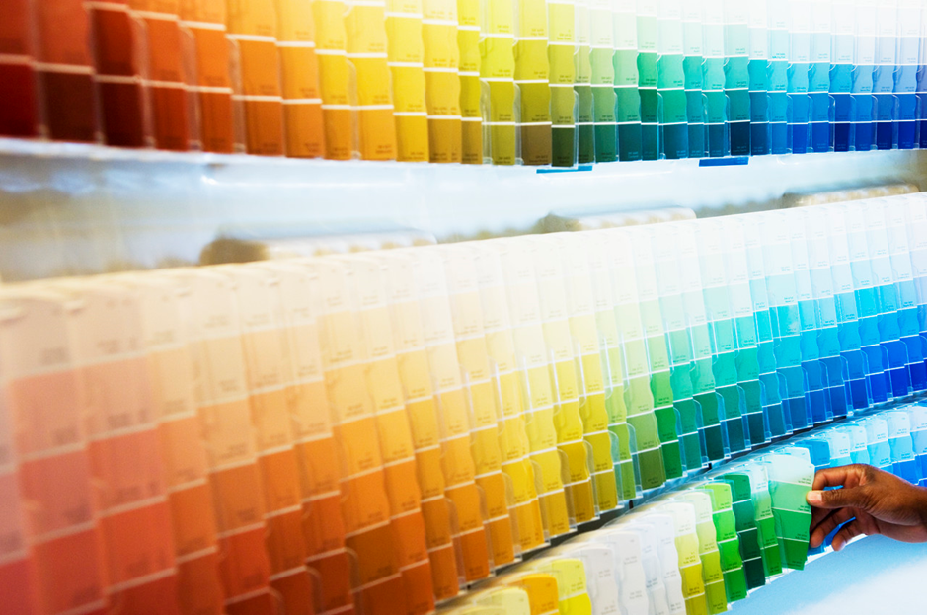
Notes:
Discuss the way in which colours can trigger the senses.
Look at a colour chart in English (search “paint colour chart” on https://images.google.com/)
The colours have been given names that help us imagine them more vividly.
What senses are associated with each of these colours? Discuss with partners. Choose 2 or 3 and write in them in the corresponding box on the sense grid with a brief explanation.

Slide 4
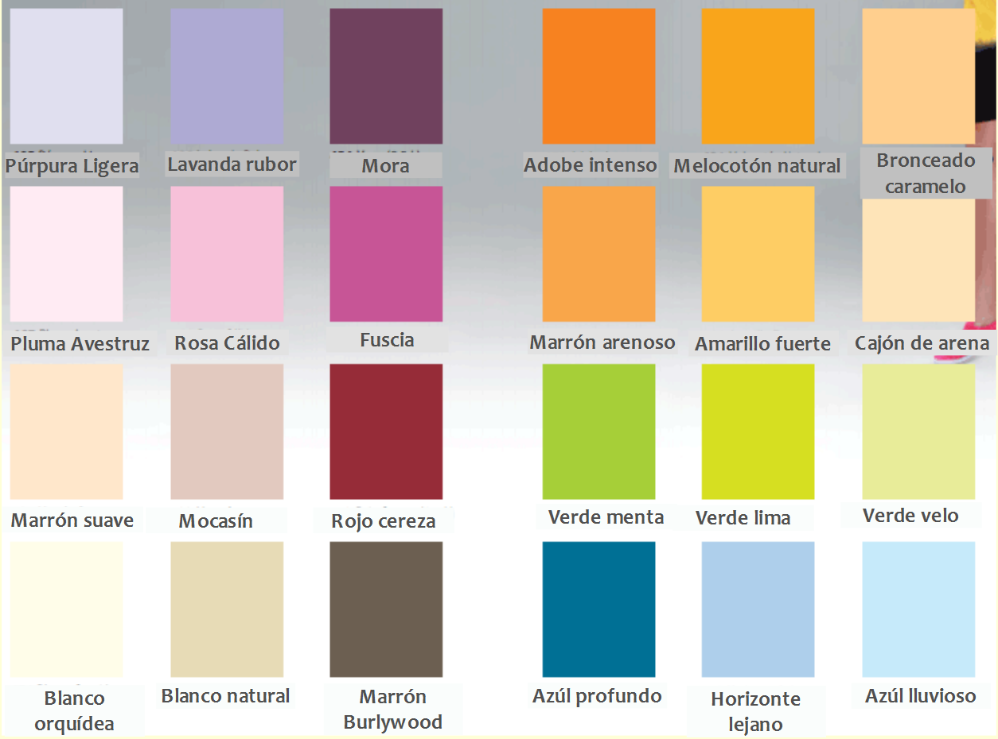
Notes:
Now look at Spanish colour chart. Using the glossary, try to find a different colour which evokes each one of the five senses. Write this colour in Spanish in the correct sense box on the grid and a brief note in English explaining your answer. Discuss.

Slide 5
“Colour crackle, colours roar.”
By Pat Mora
Notes:
Read poem by Pat Mora (http://missrumphiuseffect.blogspot.co.uk/2009/04/poetry-makers-pat-mora.html). Discuss;
Colour and senses: Look at the verbs, highlight all the verbs being used. Which sense is most strongly evoked by the verbs in this poem?
Highlight the nouns. To which objects does she compare each colours?
Use of mother tongue. Why does she use Spanish and English? Is it because she learned colours in her first(childhood) language?

